Slide 1
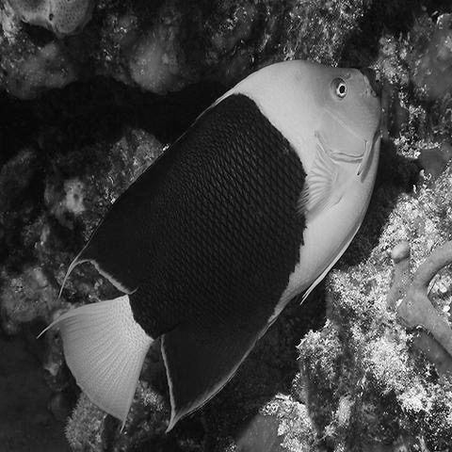
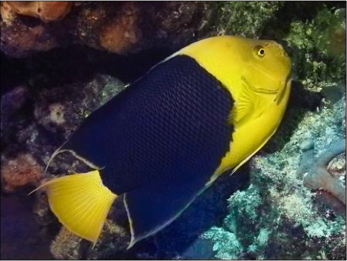

1
Convolutional Network for Image Synthesis
Jun-Yan Zhu 16-726 Learning-based Image Synthesis, Spring 2021
many slides from Alyosha Efros, Phillip Isola, Richard Zhang, James Hays, and Andrea Vedaldi, Jitendra Malik.
© Zhang et al., ECCV 2016

Slide 2
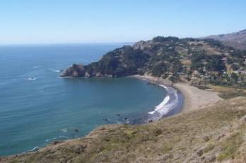
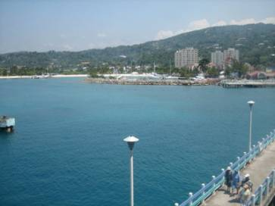
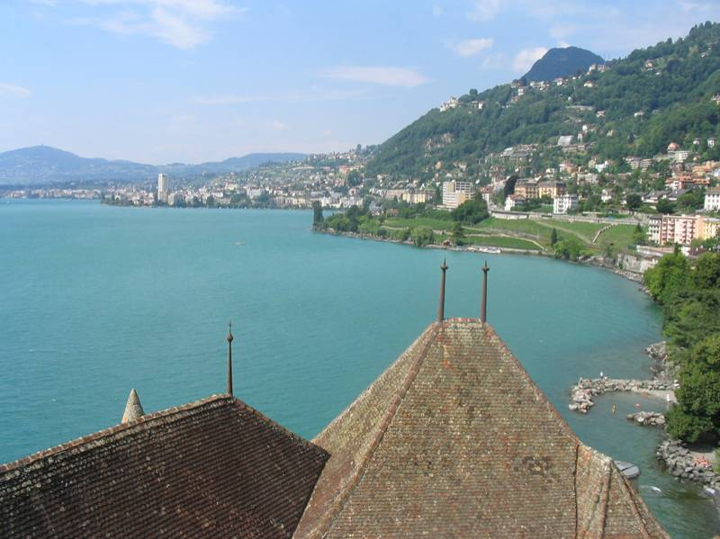
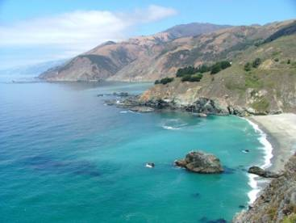




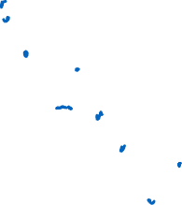



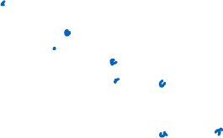
Review (data-driven graphics)

Slide 3
Review (data-driven graphics)
Nearest neighbor methods:
1. Stored examples
2. Calculate distance between two examples
3. Voting (label transfer): image blending/averaging

Slide 4
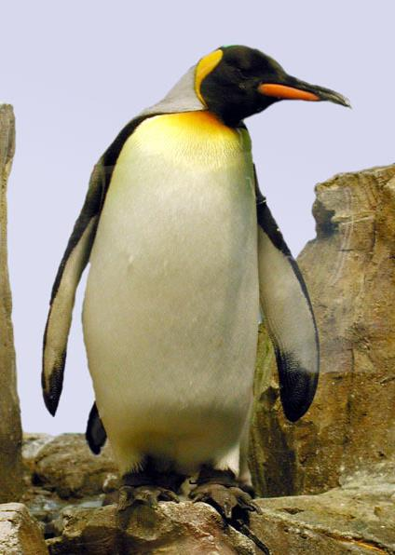
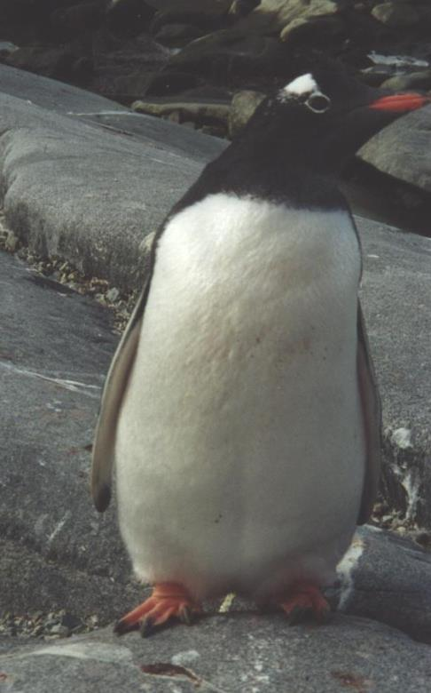
Visual similarity via labels
?
==
“Penguin”
“Penguin”

Slide 5
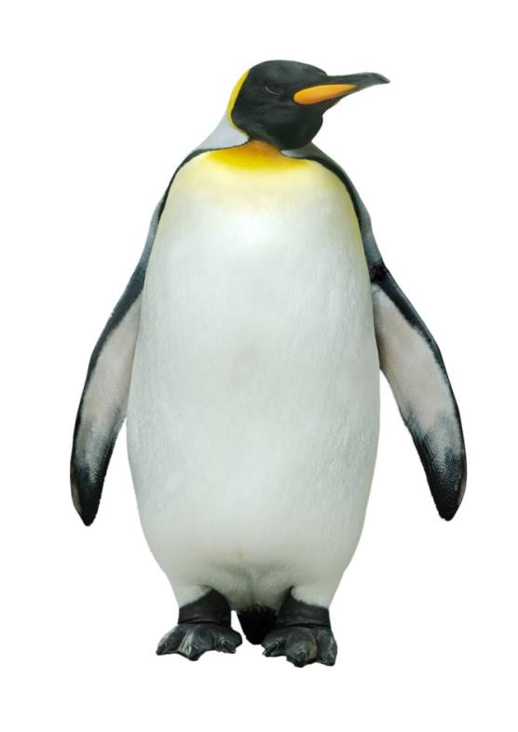

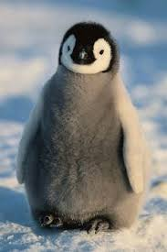
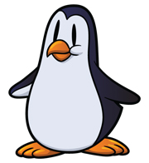
Machine Learning as data association
black box
classifier
“Penguin”
image X
label Y

Slide 6
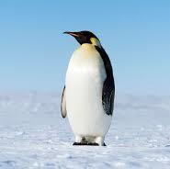
At test time…
black box
classifier
?
image X

Slide 7
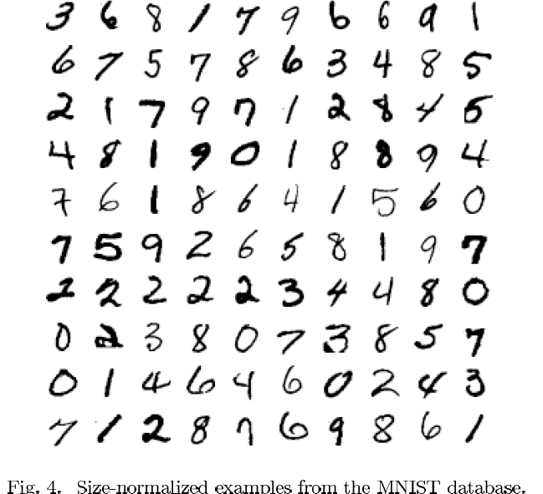
Examples from MNIST dataset [LeCun. 1998]

Slide 8

Warm-up Example: Binary Digit Classification
vs.

Slide 9

Learning Approach to Digit Recognition
Collect Training Images
Positive:
Negative:
Training Time
Compute feature vectors for positive and negative example images
Train a classifier
Test Time
Compute feature vector on new test image:
Evaluate classifier

Slide 10
Let us take an example…

Slide 11
Let us take an example…

Slide 12
In feature space, positive and negative examples are just points…

Slide 13
How do we classify a new point?

Slide 14
Nearest neighbor rule “transfer label of nearest example”

Slide 15
Linear classifier rule

Slide 16
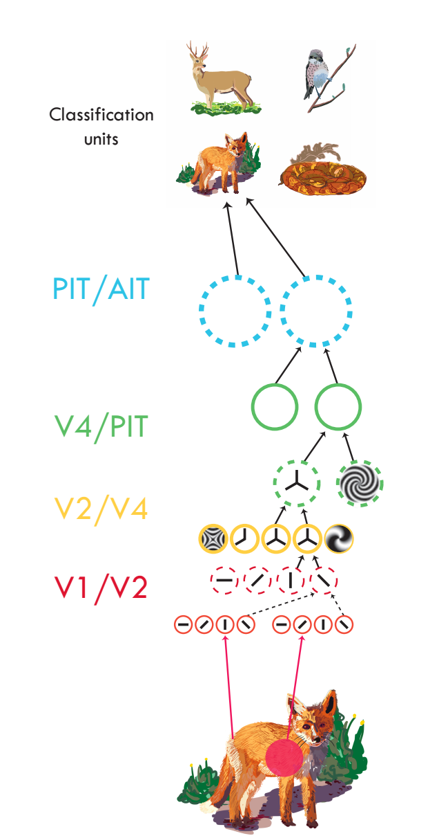
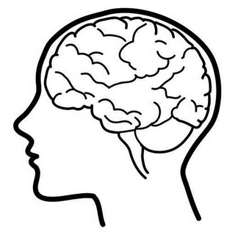
Serre, 2014

Slide 17
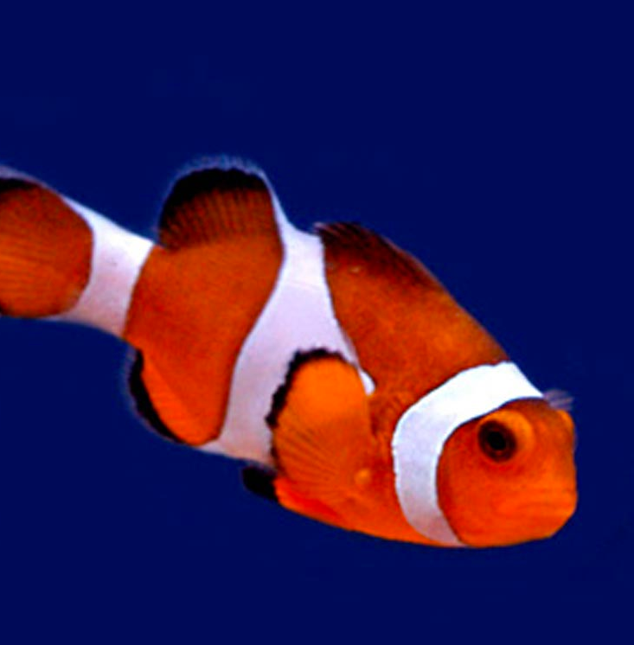
Basic idea
“clown fish”
Brain/Machine

Slide 18
Object recognition
Edges
Segments
“clown fish”
Texture
Parts
Colors
Feature extractors
Classifier

Slide 19

Object recognition
Learned
Edges
Segments
“clown fish”
Texture
Parts
Colors
Feature extractors
Classifier

Slide 20
Neural network
Learned
“clown fish”

Slide 21
Neural network
Learned
“clown fish”

Slide 22
Deep neural network
Learned
“clown fish”
Notes:
Take some data input. Process it through a hierarchy of simple computational units. Units are reused in stereotyped fashion. Produce some output.

Slide 23
Computation in a neural net
Input representation
Output representation

Slide 24
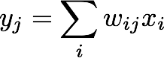
Computation in a neural net
Input representation
Output representation
i: the $i^{th}$ dimension of $x$, j; the $j^{th}$dimension of $y$

Slide 25
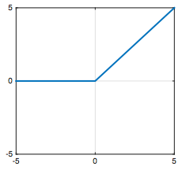
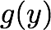
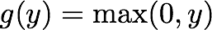
Computation in a neural net
Rectified linear unit (ReLU)

Slide 26
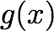
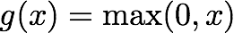
Computation in a neural net
Rectified linear unit (ReLU)

Slide 27
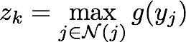
Computation in a neural net
Filter
Pool
i: the $i^{th}$ dimension of $x$, j; the $j^{th}$dimension of $y$
Notes:
mention bias term?

Slide 28


Computation in a neural net
CS231n at Stanford

Slide 29
Computation in a neural net
Filter
ReLU
Pool
Classify
“clown fish”
…

Slide 30
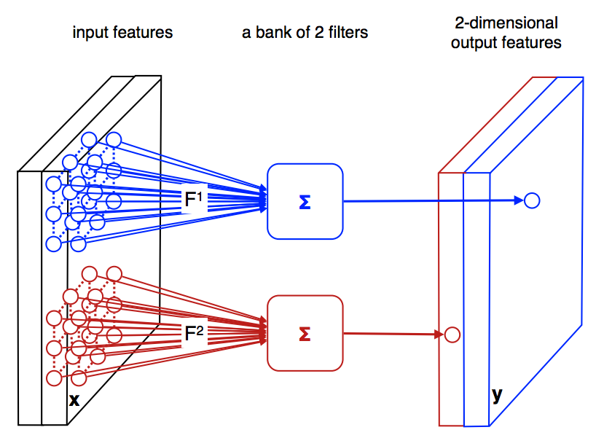
Convolutional Neural Nets
Slide from Andrea Vedaldi

Slide 31

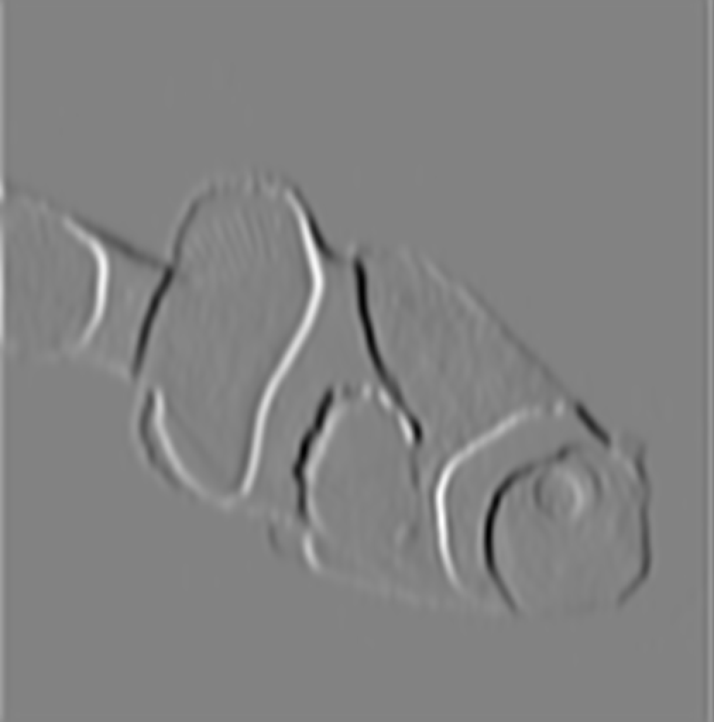
Convolutional Neural Nets
Convolution
filter

Slide 32
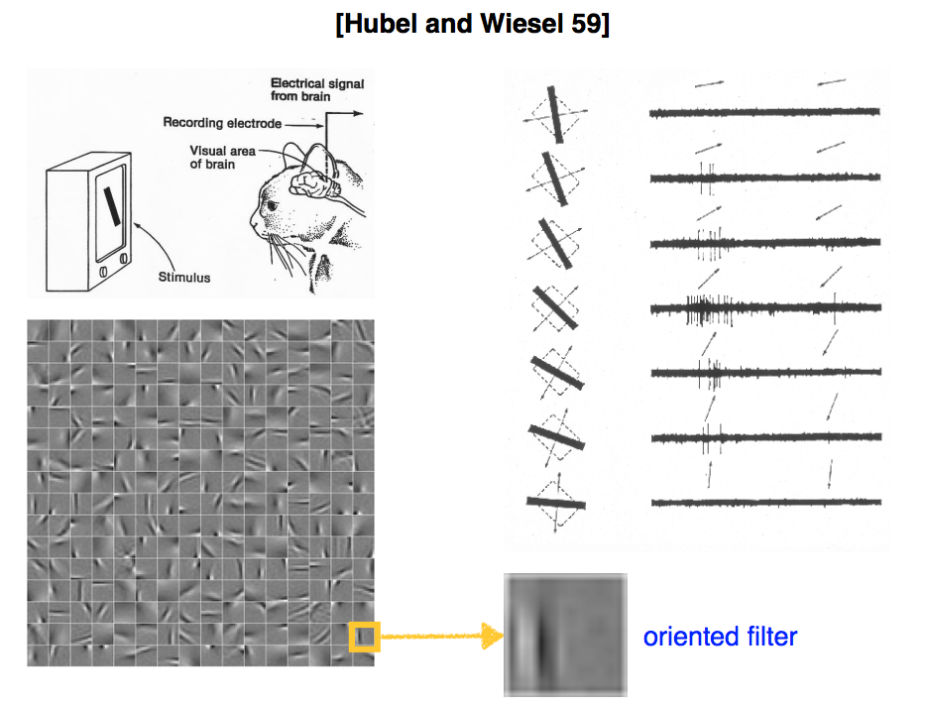
Slide from Andrea Vedaldi

Slide 33
Computation in a neural net
Last layer
dolphin
cat
grizzly bear
angel fish
“clown fish”
…
argmax
chameleon
clown fish
iguana
elephant
…

Slide 34
Learning with deep nets
Learned
“clown fish”

Slide 35
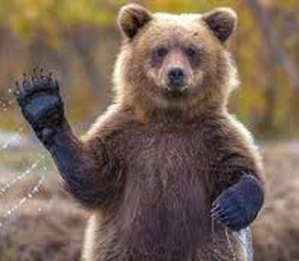
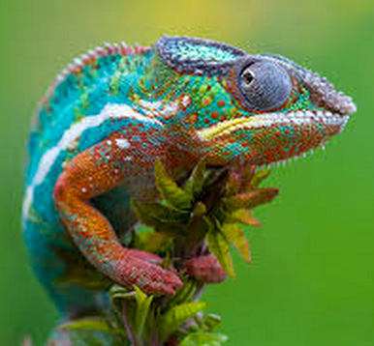
Learning with deep nets
“clown fish”
Train network to associate the right label with each image
“grizzly bear”
“chameleon”

Slide 36
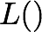

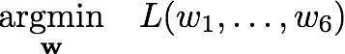
Learning with deep nets
Learned
“clown fish”
Loss

Slide 37
Loss function
Network output
Ground truth label
“clown fish”
dolphin
cat
grizzly bear
angel fish
Loss
error
…
chameleon
clown fish
iguana
elephant
…

Slide 38
Loss function
Network output
Ground truth label
“clown fish”
dolphin
cat
grizzly bear
angel fish
Loss
small
…
chameleon
clown fish
iguana
elephant
…

Slide 39
Loss function
Network output
Ground truth label
“grizzly bear”
dolphin
cat
grizzly bear
angel fish
Loss
large
…
chameleon
clown fish
iguana
elephant
…

Slide 40
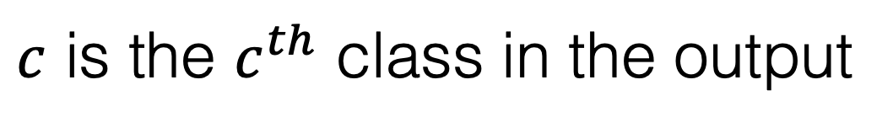
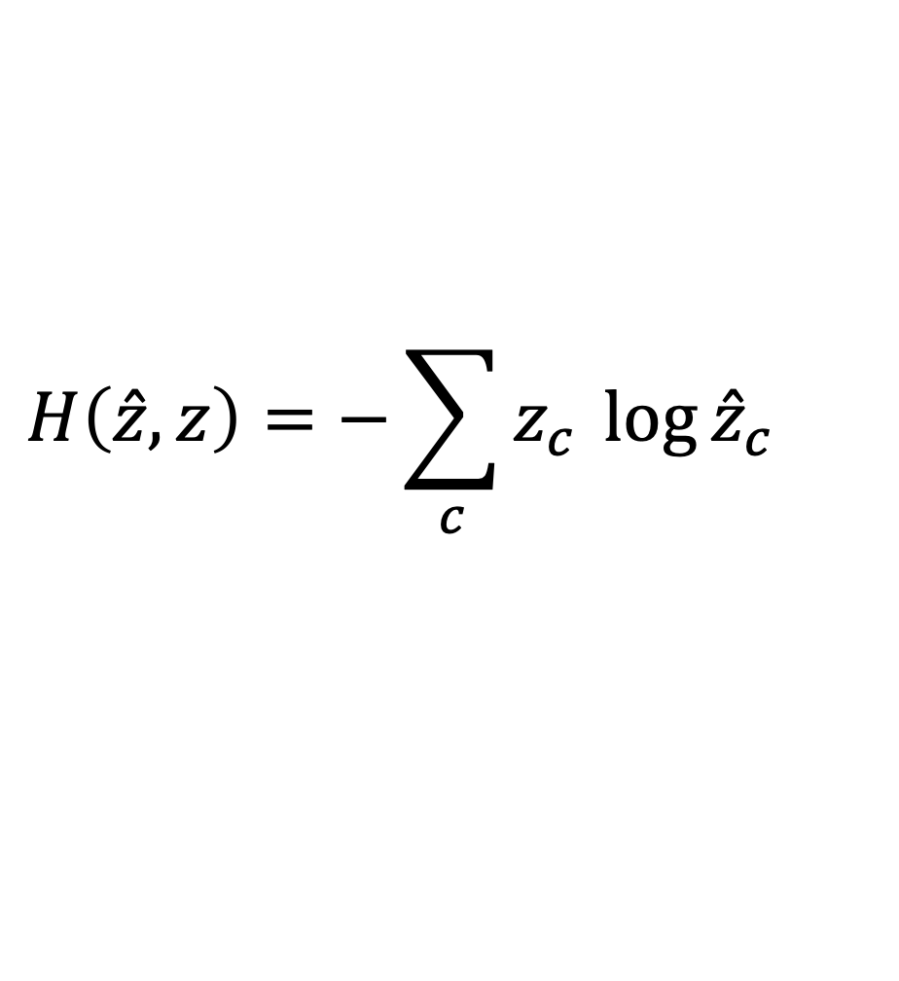
Loss function for classification
Network output
Ground truth label
dolphin
Probability of the observed data under the model
cat
grizzly bear
angel fish
…
chameleon
$$H\left(\hat{z}, z\right)=−\sum_{c}{z_{c}^{}log{{{\hat{z}}_{c}^{}}_{}}}$$
clown fish
iguana
Cross-entropy loss
elephant
…
…
$c$ is the $c^{th}$ class in the output

Slide 41
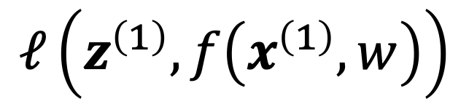
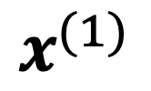
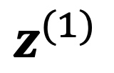
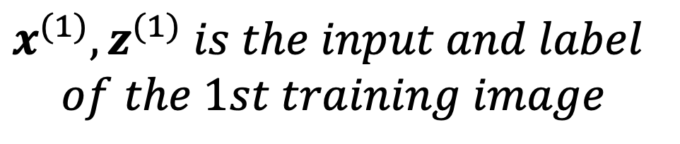
Learning with deep nets
Learned
$$z^{(1)}$$
“clown fish”
$$x^{(1)}$$
Loss
$$ℓ\left(z^{\left(1\right)}, f\left(x^{\left(1\right)}, w\right)\right)$$
$$x^{(1)}, z^{(1)} is the input and label$$
$$of the 1st training image$$

Slide 42
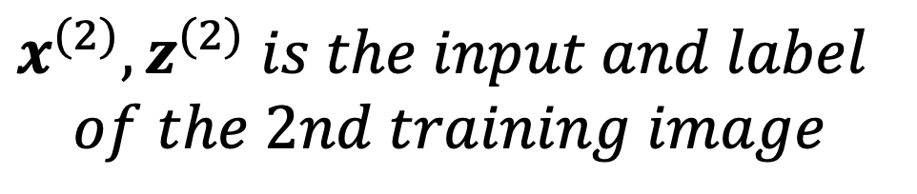
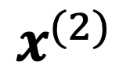
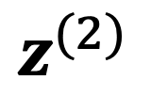
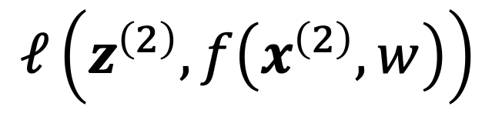
Learning with deep nets
Learned
$$z^{(2)}$$
“grizzly bear”
$$x^{(2)}$$
Loss
$$ℓ\left(z^{\left(2\right)}, f\left(x^{\left(2\right)}, w\right)\right)$$
$$x^{(2)}, z^{(2)} is the input and label$$
$$of the 2nd training image$$

Slide 43
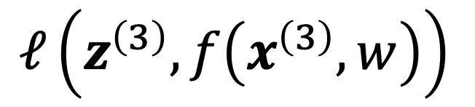
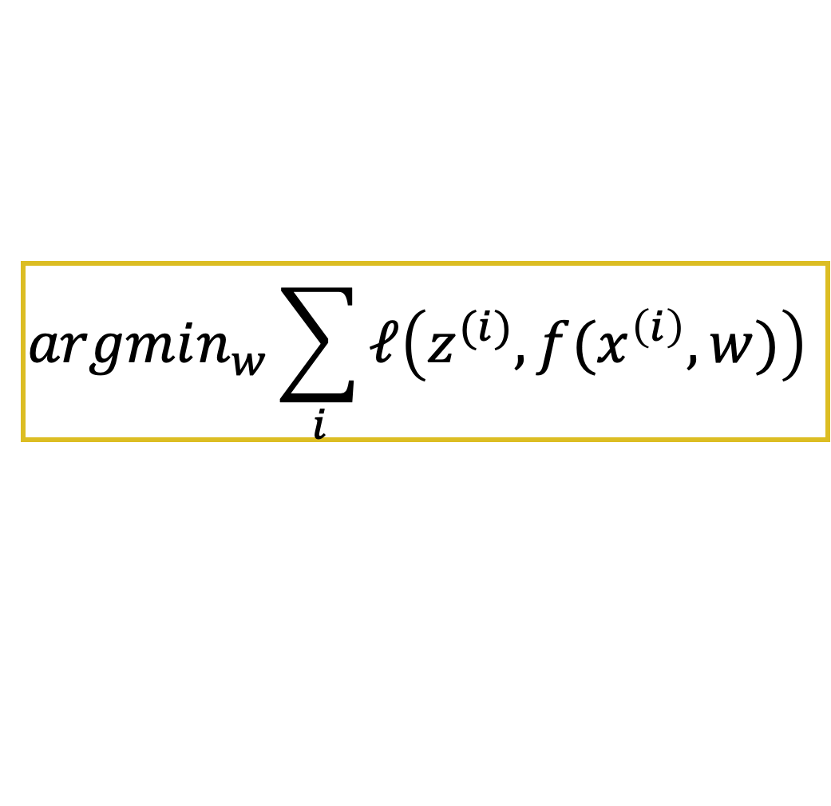
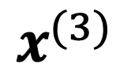
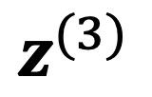
Learning with deep nets
Learned
$$z^{(3)}$$
“chameleon”
$$x^{(3)}$$
Loss
$$ℓ\left(z^{\left(3\right)}, f\left(x^{\left(3\right)}, w\right)\right)$$
$$argmin_{w}\sum_{i}{ℓ\left(z^{(i)}, f(x^{\left(i\right)}, w)\right)}$$

Slide 44
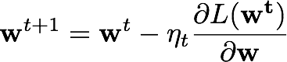
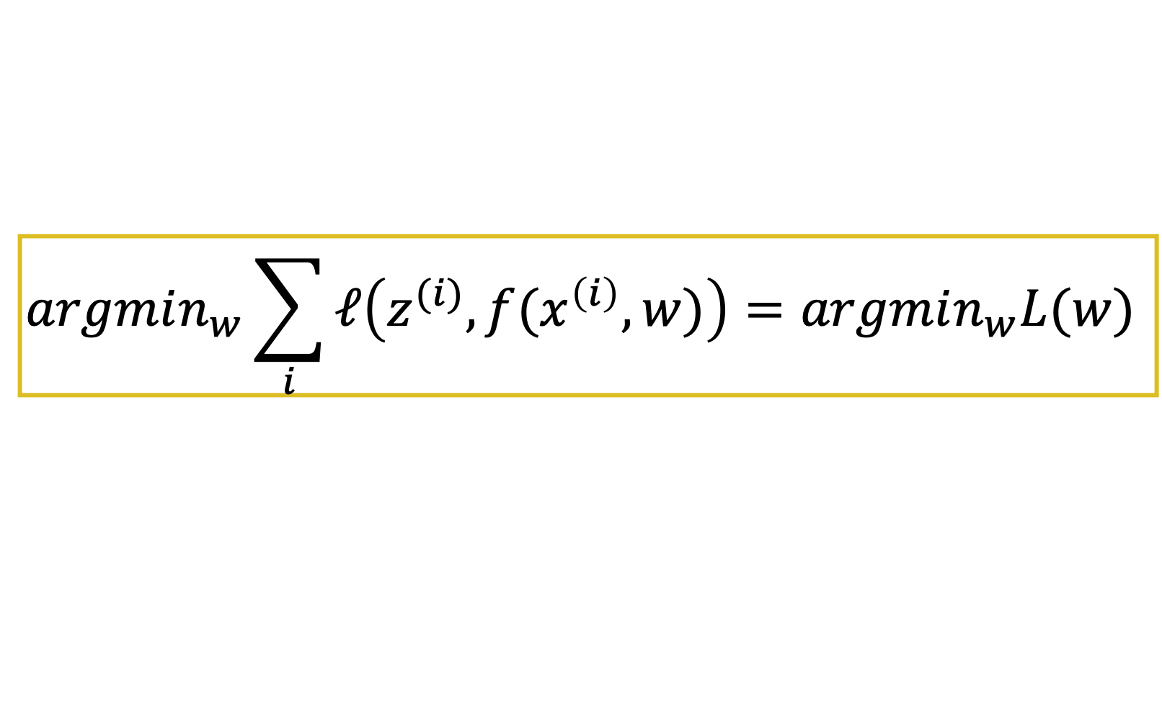
Gradient descent
$$argmin_{w}\sum_{i}{ℓ\left(z^{(i)}, f(x^{\left(i\right)}, w)\right)}=argmin_{w}L(w)$$
One iteration of gradient descent:
learning rate

Slide 45
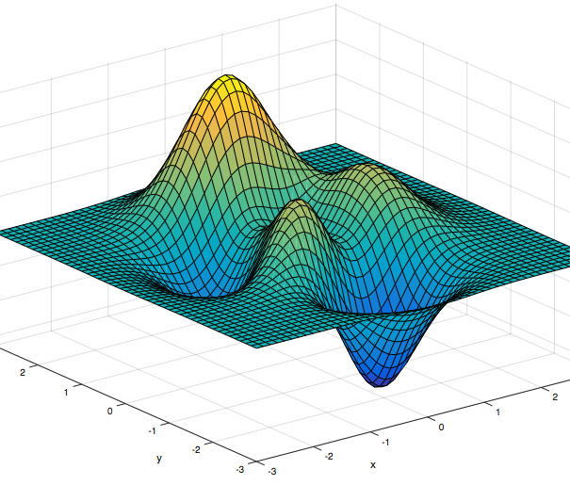
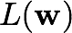
Gradient descent

Slide 46


[Krizhevsky et al. NIPS 2012]

Slide 47



Computer Vision before 2012
Cat
Features
Clustering
Pooling
Classification

Slide 48
Computer Vision Now
Cat
Features
Clustering
Pooling
Classification
Cat
Deep Net
[LeCun et al, 1998], [Krizhevsky et al, 2012]

Slide 49




Deep Learning for Computer Vision
Deep Net
[Deng et al. 2009]
Top 5 accuracy on ImageNet benchmark
[Redmon et al., 2018]
[Güler et al., 2018]
[Zhao et al., 2017]
Object detection
Human understanding
Autonomous driving

Slide 50




Can Deep Learning Help Graphics?
Cat
Modeling
Texturing
Lighting
Rendering

Slide 51
Can Deep Learning Help Graphics?
Cat
Modeling
Texturing
Lighting
Rendering
Did not work
Cat
Deep Net

Slide 52

Generating images is hard!
Cat
Modeling
Texturing
Lighting
Rendering
8
Deep Net
28x28 pixels

Slide 53





…
“yellow”

Slide 54
Discriminative Deep Networks
“Rockfish”

Slide 55
Discriminative Deep Networks
Raw, Unlabeled Pixels

Slide 56
Generative Deep Networks
Raw, Unlabeled Pixels

Slide 57


Fractionally-strided Convolution
Regular conv
Fractiaionally-strided conv
© David Dau

Slide 58

Generating chairs given ID, viewpoint, and transformation parameters
Dosovitskiy et al. Learning to Generate Chairs, Tables and Cars with Convolutional Networks
PAMI 2017 (CVPR 2015)

Slide 59

Generating chairs given ID, viewpoint, and transformation parameters
Dosovitskiy et al. Learning to Generate Chairs, Tables and Cars with Convolutional Networks
PAMI 2017 (CVPR 2015)

Slide 60


Ansel Adams. Yosemite Valley Bridge.

Slide 61




Grayscale image: L channel
Color information: ab channels
L
ab
Zhang, Isola, Efros. Colorful Image Colorization. In ECCV, 2016.

Slide 62


Grayscale image: L channel
Concatenate (L,ab) channels
L
ab
Zhang, Isola, Efros. Colorful Image Colorization. In ECCV, 2016.

Slide 63




Simple L2 regression doesn’t work ☹
Input
Output
Ground truth

Slide 64




Slide 65





Better Loss Function
Colors in ab space
(discrete)
Regression with L2 loss inadequate
Use per-pixel multinomial classification

Slide 66



Slide 67

Designing loss functions
Input
Zhang et al. 2016
Ground truth
Color distribution cross-entropy loss with colorfulness enhancing term.
[Zhang, Isola, Efros, ECCV 2016]

Slide 68

Thank You!
16-726, Spring 2021
https://learning-image-synthesis.github.io/

